Slide 1

SOCIAL MEDIA ANALYTICS
Anita Yadav
Pranav Garg
Dhruv Arora
Pratyush Rohilla
Gaurav Shukla
Understanding Radicalization through Network Analysis

Slide 2

OBJECTIVE : EXPLORE RADICALIZATION NETWORKS BY ANALYZING THE CONNECTIONS, INFLUENCE, AND STRUCTURE OF INDIVIDUALS WITHIN RADICALIZED GROUPS.
Key Questions:
Who are the most central and influential individuals in radicalization networks?
How do individuals cluster and form sub-groups within networks?
What are the most common pathways of radicalization based on network structures?
Can network properties help in identifying early indicators of radicalization?

Slide 3

DATASET OVERVIEW
PIRUS : Publicly available dataset Developed by the National Consortium for START
It contains detailed information on radicalized individuals in the U.S.
Data from 1948 to the present
Demographic details of individuals
Their ideological affiliations
The radicalization process they underwent
Their criminal activities
PIRUS : Profiles of Individual Radicalization in the United States
START : Study of Terrorism and Responses to Terrorism

Slide 4
GRAPH STATISTICS OVERVIEW
Metric | Value
Total Nodes | 4088
Total Edges | 14355
Network Density | 0.000859
Number of communities | 587
Largest Community Size | 323
Average Node Degree | 7.022994
Max Node Degree | 71

Slide 5
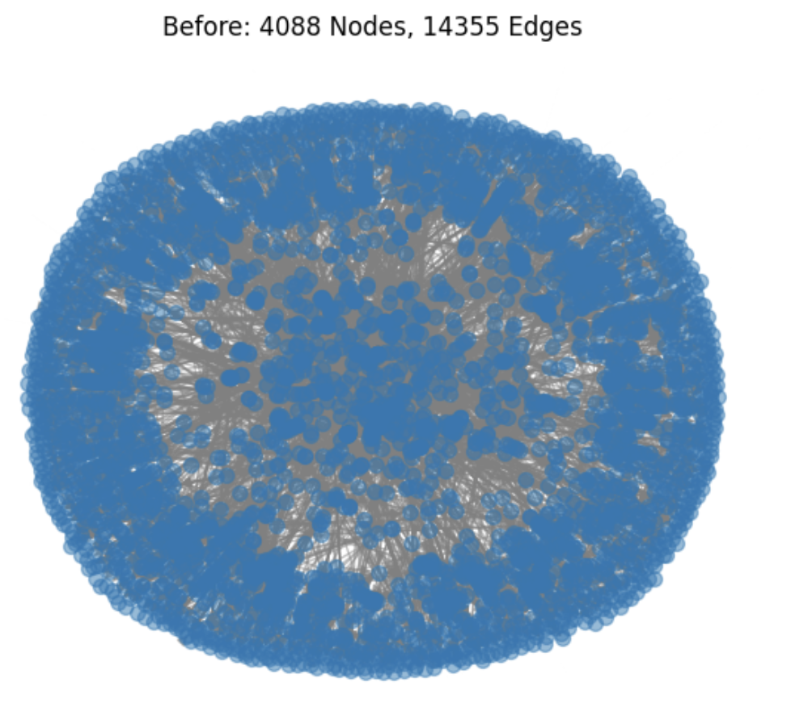
OVERALL NETWORK Greedy modularity algorithm used to find communities

Slide 6
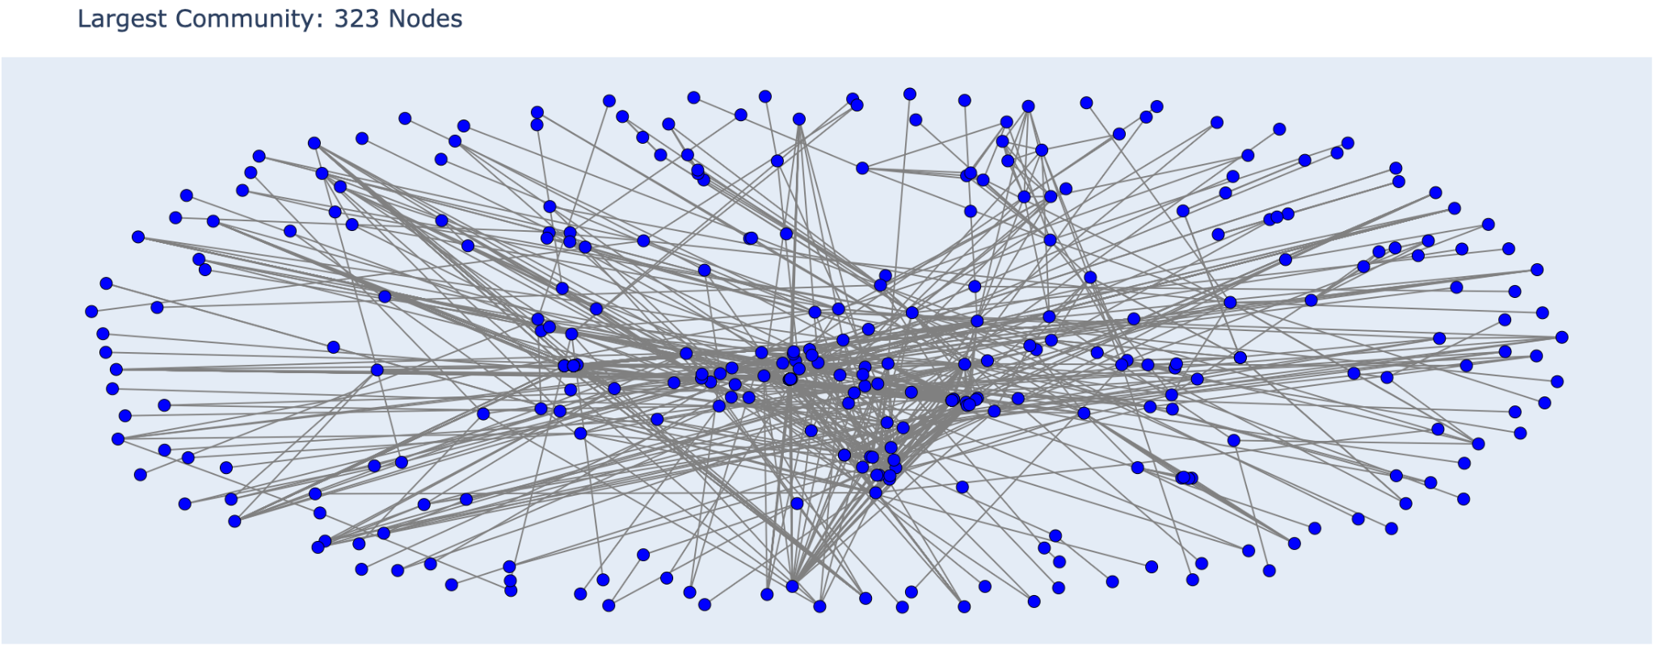
KEY N/W COMPONENT : LARGEST CONNECTED SUBGRAPH

Slide 7
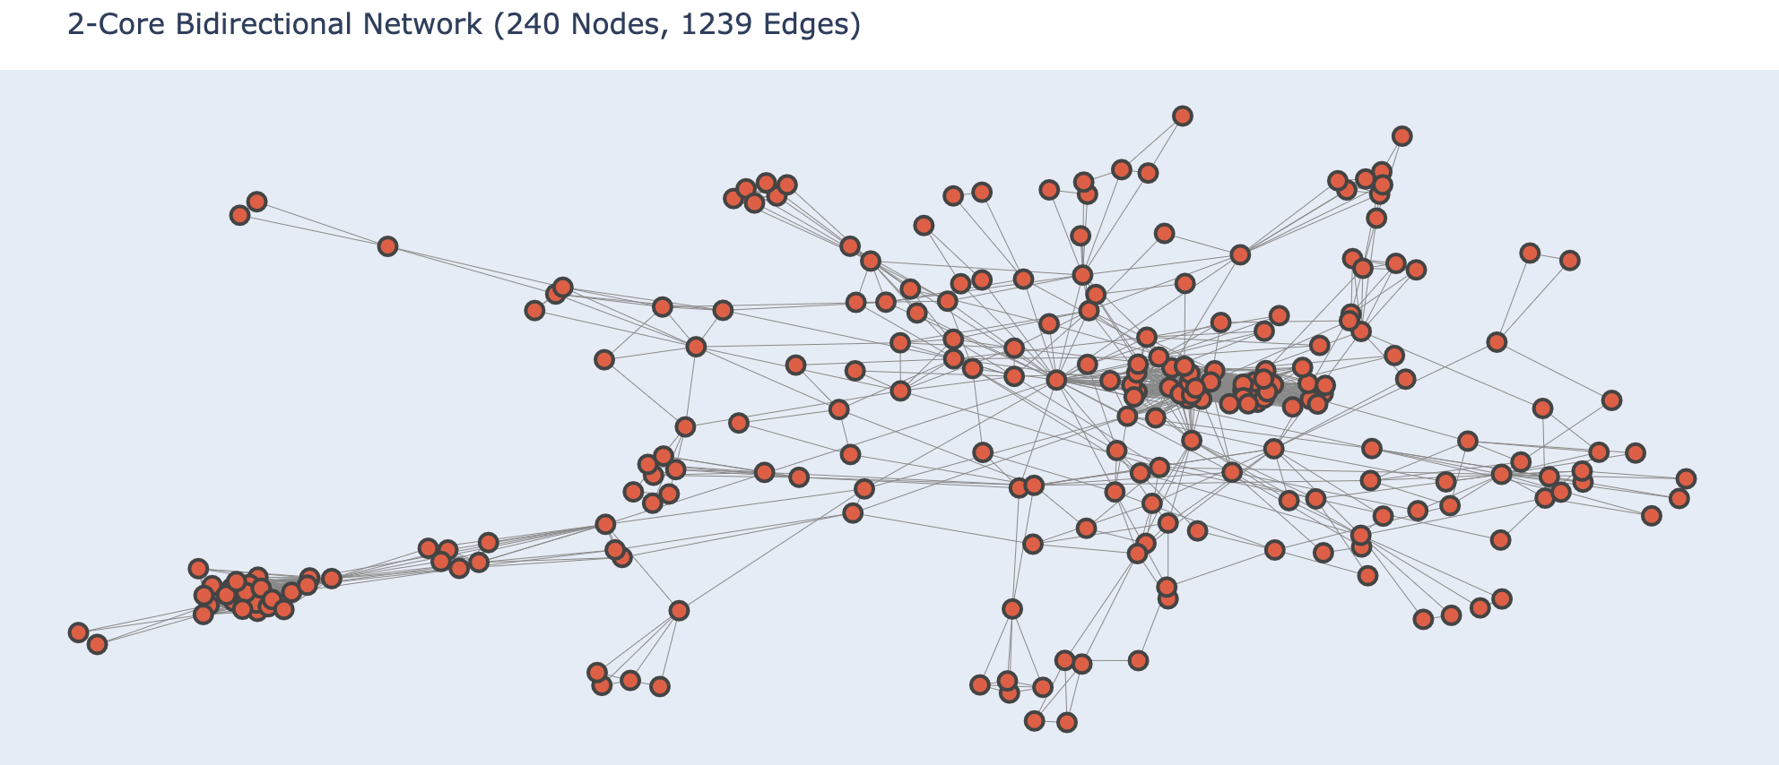
2-core Largest N/W

Slide 8
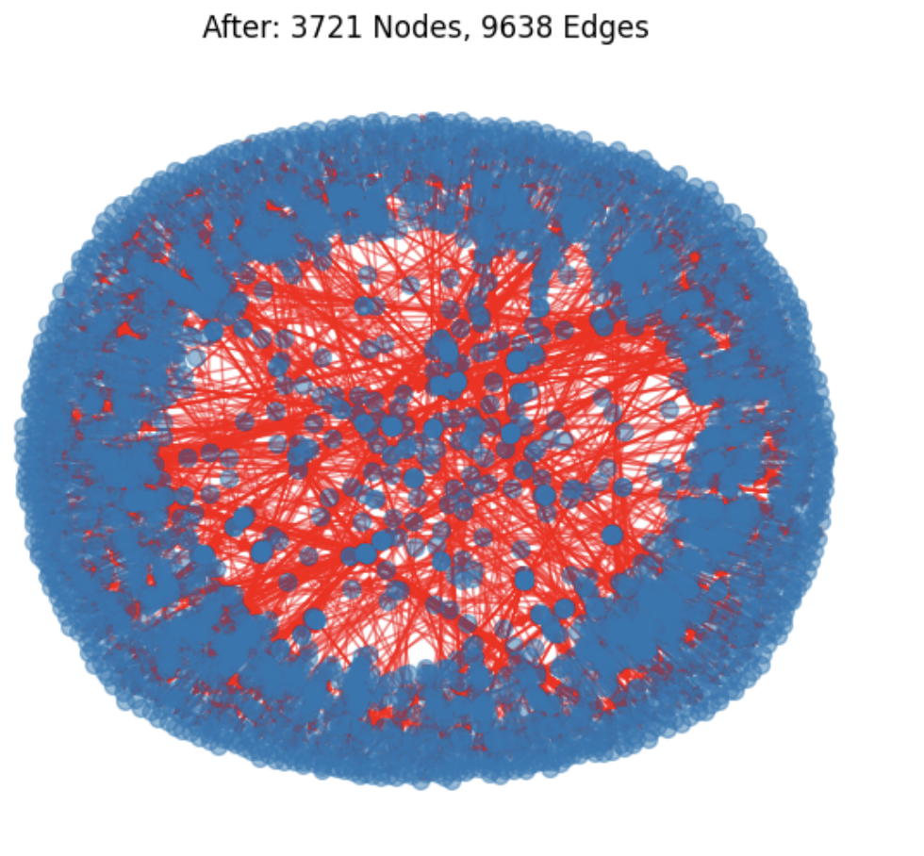
DOES THE N/W COLLAPSE : REMOVING KEY INDIVIDUALS (BASED ON BETWEENNESS )
Metric | Before Removal | After Removal | % change
Total Nodes | 4088 | 3721 | 10%
Total Edges | 14355 | 9638 | 33%
# of communities | 587 | 915 | 55%
Largest Cluster | 323 | 95 | 70%
Notes:
Key Insights
1️⃣ High-Betweenness Nodes Were Critical Bridges
The large drop in edges (4,717 lost) confirms that these nodes were highly connected individuals, serving as links between groups.
Their removal drastically reduced communication pathways, making the network less cohesive.
2️⃣ The Network Becomes Highly Fragmented
The number of communities increased from 587 to 915 → A sign that the network split into smaller, disconnected clusters.
This suggests that many individuals lost their direct connections to the broader extremist network.
3️⃣ The Largest Community Lost 71% of Its Nodes
The largest connected extremist faction shrank from 323 to 95 nodes.
This means the removal of high-betweenness individuals broke up key power centers, forcing the network into smaller, less effective units.
💡 Real-World Implications
✅ Disrupting extremist networks: Removing key individuals severely weakens communication and collaboration, making radicalization and coordination harder.
✅ Preventing large-scale coordination: With fewer direct bridges, it becomes harder for groups to share resources, plan attacks, or recruit new members.
✅ Slowing down ideological spread: The fragmentation ensures that ideas don’t spread as easily, reducing the overall reach and influence of extremist groups.

Slide 9
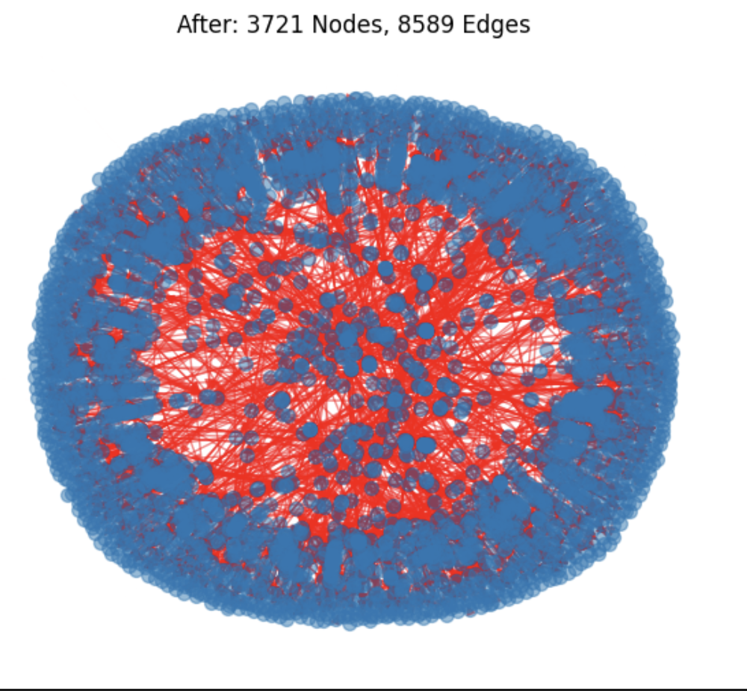
DOES THE N/W COLLAPSE : REMOVING KEY INDIVIDUALS (BETWEENNESS + DEGREE)
Metric | Before Removal | After Removal | % change
Total Nodes | 4088 | 3721 | 10%
Total Edges | 14355 | 8589 | 40%
# of communities | 587 | 849 | 44%
Largest Cluster | 323 | 119 | 63%
Notes:
Key Insights
1️⃣ The Network Shrinks More, But Stays More Connected
More edges are lost (5,766 vs. 4,717 in the previous analysis), meaning that removing high-degree nodes eliminated many direct connections.
However, fewer new communities are formed (849 vs. 915), which means that removing high-degree nodes prevented extreme fragmentation by eliminating highly clustered groups.
2️⃣ Largest Community Shrinks Less Than Before
The largest community remains slightly larger (119 nodes) compared to just betweenness removal (95 nodes).
This suggests that some small disconnected groups merged back into the remaining structure, making it more resilient in some ways.
3️⃣ More Structural Weakening, But Less Fragmentation
The network is now less connected overall (fewer edges), but it is less fragmented than before.
This happens because high-degree nodes often have many redundant links, so removing them doesn't isolate as many small groups as removing just high-betweenness nodes.

Slide 10



The extremist network is NOT resilient to a multi-node attack. Hence, Targeting both high-degree and high-betweenness nodes is an effective strategy.
WHAT THIS MEANS?
Extremist cells are now small and disconnected, preventing large-scale coordination
Conclusion : Targeting both betweenness & degree centrality nodes effectively resets leadership → Old influencers were completely removed from power.
Notes:
Why is the Largest Community Bigger When Removing More Nodes?
Even though both analyses remove 367 nodes, the structure of the remaining nodes changes based on who was removed.
🔹 Removing Only High-Betweenness Nodes (First Case)
The network fragments quickly because key "bridges" between communities disappear.
Many small communities emerge as individuals lose their interconnections.
The largest community loses key links, leading to a smaller size (95 nodes).
🔹 Removing Both High-Betweenness and High-Degree Nodes (Second Case)
Some high-degree nodes may have been holding fragmented groups together.
By removing them, some smaller clusters get absorbed into the largest remaining group.
Instead of the network completely breaking apart, the structure reorganizes, leaving a larger central community (119 nodes).
📌 Key Insight:
High-degree nodes can act as "hubs" that absorb disconnected groups when bridges are removed.
Removing only betweenness nodes isolates groups, but removing both types can sometimes consolidate remaining communities.

Slide 11
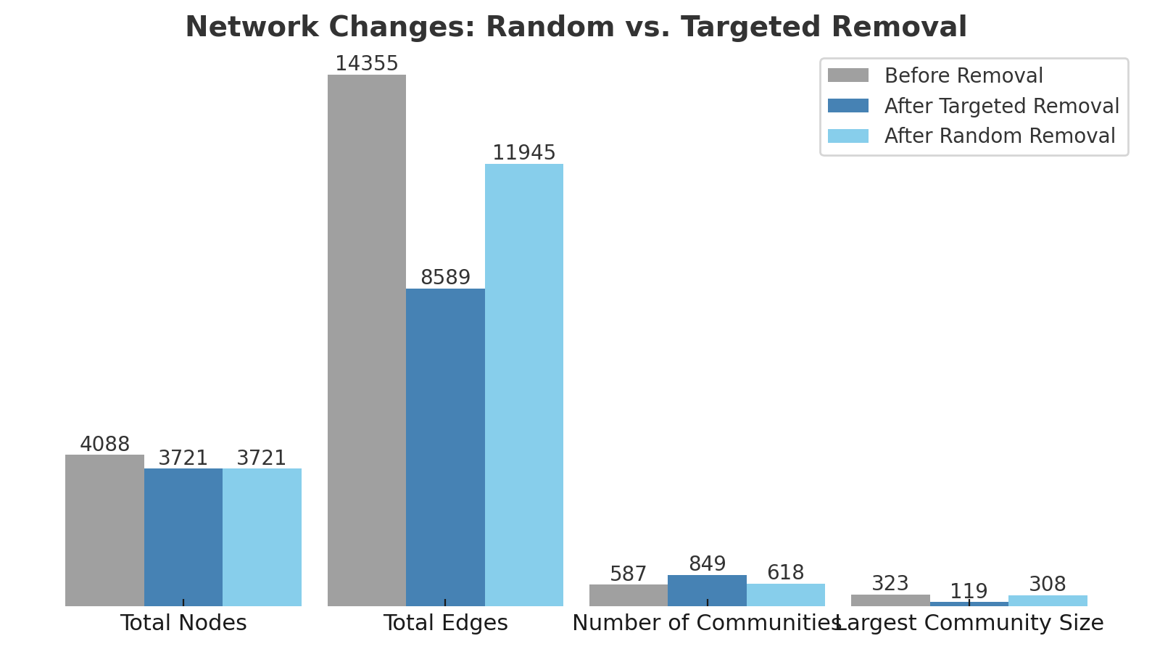
CAN RANDOM REMOVAL WORK?
Conclusion :
Random removal causes less fragmentation compared to targeted removals, indicating that disrupting the network effectively requires removing key nodes.
Notes:
Why is the Largest Community Bigger When Removing More Nodes?
Even though both analyses remove 367 nodes, the structure of the remaining nodes changes based on who was removed.
🔹 Removing Only High-Betweenness Nodes (First Case)
The network fragments quickly because key "bridges" between communities disappear.
Many small communities emerge as individuals lose their interconnections.
The largest community loses key links, leading to a smaller size (95 nodes).
🔹 Removing Both High-Betweenness and High-Degree Nodes (Second Case)
Some high-degree nodes may have been holding fragmented groups together.
By removing them, some smaller clusters get absorbed into the largest remaining group.
Instead of the network completely breaking apart, the structure reorganizes, leaving a larger central community (119 nodes).
📌 Key Insight:
High-degree nodes can act as "hubs" that absorb disconnected groups when bridges are removed.
Removing only betweenness nodes isolates groups, but removing both types can sometimes consolidate remaining communities.

Slide 12
TRACKING THE SURVIVORS – WHO REMAINS INFLUENTIAL
Top 3 Survivors (Degree Centrality | Betweenness Centrality)
User 2057 → (0.203 | 0.000)
User 6412 → (0.161 | 0.004)
User 1121 → (0.161 | 0.018)
Takeaway: Some key figures retain control despite removals, meaning the network could rebuild over time.
Notes:
Why is the Largest Community Bigger When Removing More Nodes?
Even though both analyses remove 367 nodes, the structure of the remaining nodes changes based on who was removed.
🔹 Removing Only High-Betweenness Nodes (First Case)
The network fragments quickly because key "bridges" between communities disappear.
Many small communities emerge as individuals lose their interconnections.
The largest community loses key links, leading to a smaller size (95 nodes).
🔹 Removing Both High-Betweenness and High-Degree Nodes (Second Case)
Some high-degree nodes may have been holding fragmented groups together.
By removing them, some smaller clusters get absorbed into the largest remaining group.
Instead of the network completely breaking apart, the structure reorganizes, leaving a larger central community (119 nodes).
📌 Key Insight:
High-degree nodes can act as "hubs" that absorb disconnected groups when bridges are removed.
Removing only betweenness nodes isolates groups, but removing both types can sometimes consolidate remaining communities.

Slide 13
WHICH COMMUNITIES WERE AFFECTED THE MOST ?
Community ID | Size Before | Size After | % Reduction
0 | 323 | 119 | 🔻 63%
2 | 148 | 64 | 🔻 57%
1 | 154 | 76 | 🔻 50%
Decentralized communities survived better.
Hierarchical structures collapsed the most.
Notes:
Why is the Largest Community Bigger When Removing More Nodes?
Even though both analyses remove 367 nodes, the structure of the remaining nodes changes based on who was removed.
🔹 Removing Only High-Betweenness Nodes (First Case)
The network fragments quickly because key "bridges" between communities disappear.
Many small communities emerge as individuals lose their interconnections.
The largest community loses key links, leading to a smaller size (95 nodes).
🔹 Removing Both High-Betweenness and High-Degree Nodes (Second Case)
Some high-degree nodes may have been holding fragmented groups together.
By removing them, some smaller clusters get absorbed into the largest remaining group.
Instead of the network completely breaking apart, the structure reorganizes, leaving a larger central community (119 nodes).
📌 Key Insight:
High-degree nodes can act as "hubs" that absorb disconnected groups when bridges are removed.
Removing only betweenness nodes isolates groups, but removing both types can sometimes consolidate remaining communities.

Slide 14
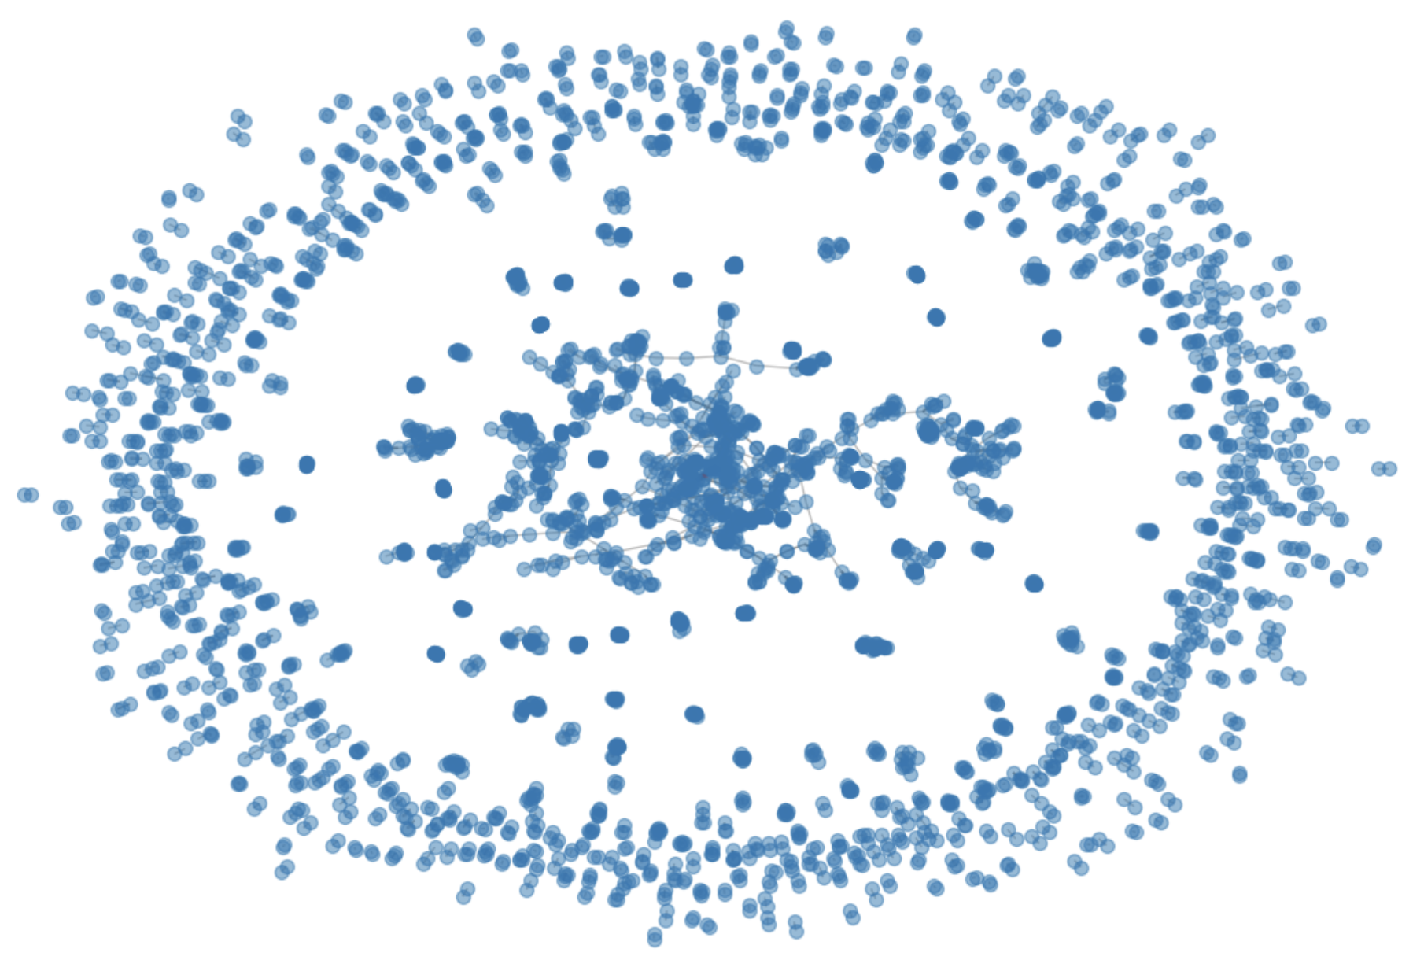
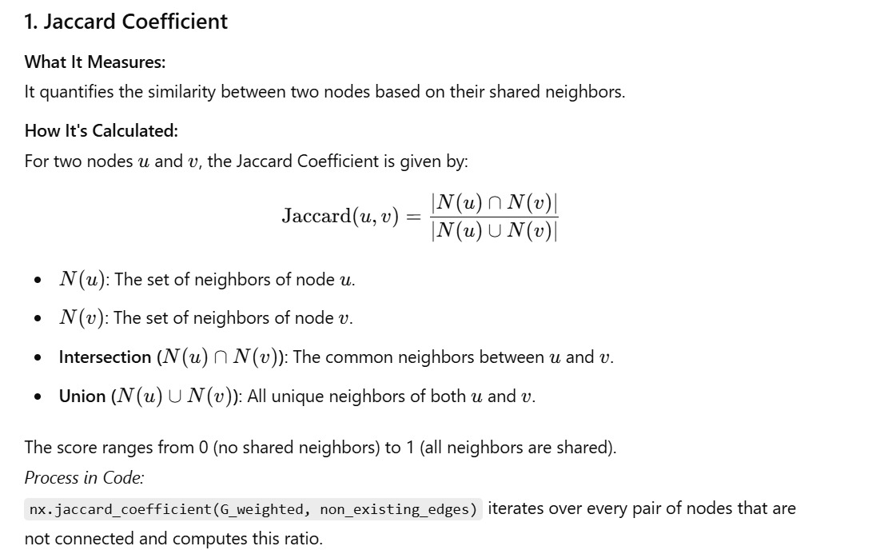
CAN THE NETWORK REBUILD?
Despite removals, the network shows potential for regrowth. Link Prediction Analysis identifies the most likely new connections based on:
Jaccard Coefficient (shared neighbors)
These nodes could act as new bridges, reestablishing lost connections.
Monitoring these connections is critical for network disruption strategies.
Notes:
Why is the Largest Community Bigger When Removing More Nodes?
Even though both analyses remove 367 nodes, the structure of the remaining nodes changes based on who was removed.
🔹 Removing Only High-Betweenness Nodes (First Case)
The network fragments quickly because key "bridges" between communities disappear.
Many small communities emerge as individuals lose their interconnections.
The largest community loses key links, leading to a smaller size (95 nodes).
🔹 Removing Both High-Betweenness and High-Degree Nodes (Second Case)
Some high-degree nodes may have been holding fragmented groups together.
By removing them, some smaller clusters get absorbed into the largest remaining group.
Instead of the network completely breaking apart, the structure reorganizes, leaving a larger central community (119 nodes).
📌 Key Insight:
High-degree nodes can act as "hubs" that absorb disconnected groups when bridges are removed.
Removing only betweenness nodes isolates groups, but removing both types can sometimes consolidate remaining communities.

Slide 15
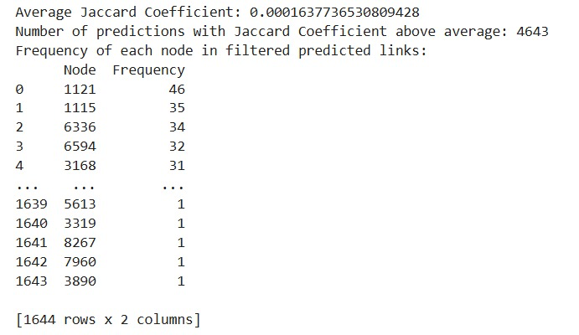
PREDICTING FUTURE EXTREMIST RECRUITERS?
4,643 potential new links identified.
High-risk nodes (e.g., 1121, 1115) appear frequently in predictions.
These nodes are likely to form multiple new extremist connections.
Implication:
Extremist networks are self-healing—new recruiters will emerge.
Monitoring predicted connections can help disrupt future recruitment.
Notes:
Why is the Largest Community Bigger When Removing More Nodes?
Even though both analyses remove 367 nodes, the structure of the remaining nodes changes based on who was removed.
🔹 Removing Only High-Betweenness Nodes (First Case)
The network fragments quickly because key "bridges" between communities disappear.
Many small communities emerge as individuals lose their interconnections.
The largest community loses key links, leading to a smaller size (95 nodes).
🔹 Removing Both High-Betweenness and High-Degree Nodes (Second Case)
Some high-degree nodes may have been holding fragmented groups together.
By removing them, some smaller clusters get absorbed into the largest remaining group.
Instead of the network completely breaking apart, the structure reorganizes, leaving a larger central community (119 nodes).
📌 Key Insight:
High-degree nodes can act as "hubs" that absorb disconnected groups when bridges are removed.
Removing only betweenness nodes isolates groups, but removing both types can sometimes consolidate remaining communities.

Slide 16

IDENTIFYING FUTURE EXTREMIST RECRUITERS
1121 & 1115: Network bridges
These nodes could act as future key recruiters or central connectors
4,643 potential new links exceeded the average Jaccard score → This means reconnections are still possible despite intervention
To weaken recruitment, disrupt faction-based influencers, not just network connectors
Notes:
Why is the Largest Community Bigger When Removing More Nodes?
Even though both analyses remove 367 nodes, the structure of the remaining nodes changes based on who was removed.
🔹 Removing Only High-Betweenness Nodes (First Case)
The network fragments quickly because key "bridges" between communities disappear.
Many small communities emerge as individuals lose their interconnections.
The largest community loses key links, leading to a smaller size (95 nodes).
🔹 Removing Both High-Betweenness and High-Degree Nodes (Second Case)
Some high-degree nodes may have been holding fragmented groups together.
By removing them, some smaller clusters get absorbed into the largest remaining group.
Instead of the network completely breaking apart, the structure reorganizes, leaving a larger central community (119 nodes).
📌 Key Insight:
High-degree nodes can act as "hubs" that absorb disconnected groups when bridges are removed.
Removing only betweenness nodes isolates groups, but removing both types can sometimes consolidate remaining communities.

Slide 17




Key Takeaways
Extremist networks are resilient – Even after removing key individuals, they try to rebuild
Strategic monitoring is crucial – Identifying these frequent connectors can help prevent recruitment and radicalization
Early intervention – Authorities can track and disrupt emerging influential nodes before they fully re-establish connections
The network does not collapse completely—it rebuilds in new forms. Intervention must target emerging connections early
Notes:
Why is the Largest Community Bigger When Removing More Nodes?
Even though both analyses remove 367 nodes, the structure of the remaining nodes changes based on who was removed.
🔹 Removing Only High-Betweenness Nodes (First Case)
The network fragments quickly because key "bridges" between communities disappear.
Many small communities emerge as individuals lose their interconnections.
The largest community loses key links, leading to a smaller size (95 nodes).
🔹 Removing Both High-Betweenness and High-Degree Nodes (Second Case)
Some high-degree nodes may have been holding fragmented groups together.
By removing them, some smaller clusters get absorbed into the largest remaining group.
Instead of the network completely breaking apart, the structure reorganizes, leaving a larger central community (119 nodes).
📌 Key Insight:
High-degree nodes can act as "hubs" that absorb disconnected groups when bridges are removed.
Removing only betweenness nodes isolates groups, but removing both types can sometimes consolidate remaining communities.

Slide 18
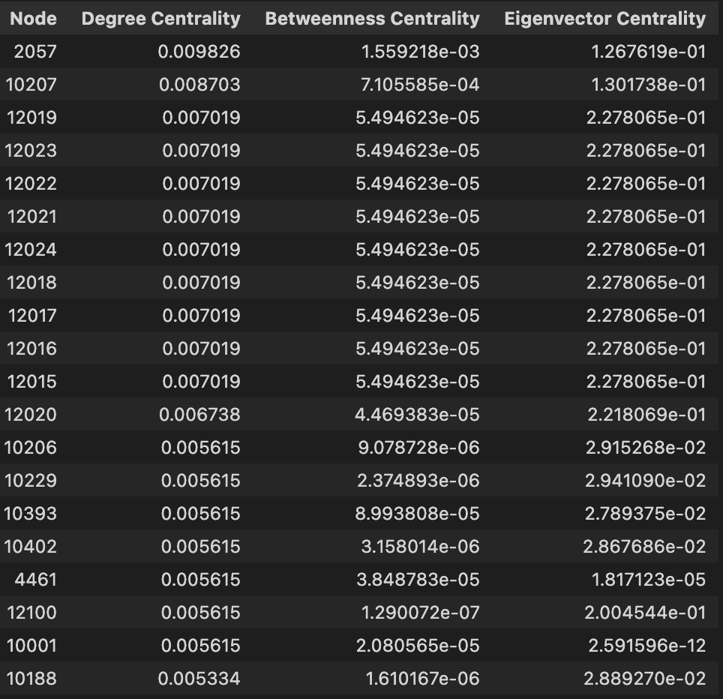
PREDICTING FUTURE EXTREMIST RECRUITERS?
Based on Degree centrality and betweenness score
Avg. Degree centrality of N/W: 0.00135
Top 5% Betweenness centrality: 3.64e-05
Avg. Eigenvector centrality: 0.0016
Notes:
Why is the Largest Community Bigger When Removing More Nodes?
Even though both analyses remove 367 nodes, the structure of the remaining nodes changes based on who was removed.
🔹 Removing Only High-Betweenness Nodes (First Case)
The network fragments quickly because key "bridges" between communities disappear.
Many small communities emerge as individuals lose their interconnections.
The largest community loses key links, leading to a smaller size (95 nodes).
🔹 Removing Both High-Betweenness and High-Degree Nodes (Second Case)
Some high-degree nodes may have been holding fragmented groups together.
By removing them, some smaller clusters get absorbed into the largest remaining group.
Instead of the network completely breaking apart, the structure reorganizes, leaving a larger central community (119 nodes).
📌 Key Insight:
High-degree nodes can act as "hubs" that absorb disconnected groups when bridges are removed.
Removing only betweenness nodes isolates groups, but removing both types can sometimes consolidate remaining communities.

Slide 19
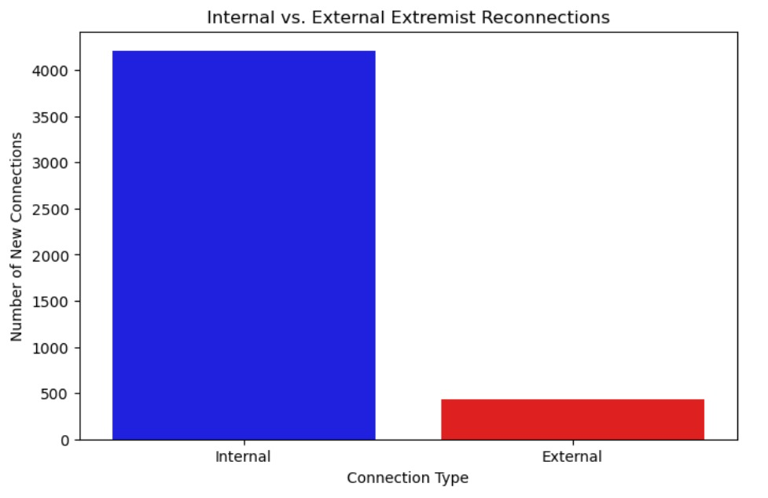
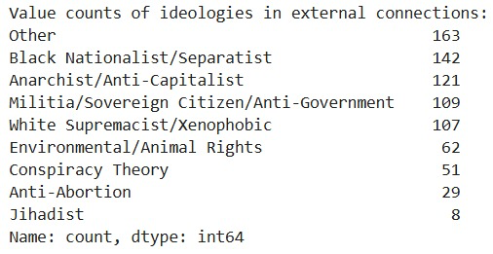
INTERNAL VS EXTERNAL IDEOLOGIES CONNECTIONS PREDICTED
Notes:
Why is the Largest Community Bigger When Removing More Nodes?
Even though both analyses remove 367 nodes, the structure of the remaining nodes changes based on who was removed.
🔹 Removing Only High-Betweenness Nodes (First Case)
The network fragments quickly because key "bridges" between communities disappear.
Many small communities emerge as individuals lose their interconnections.
The largest community loses key links, leading to a smaller size (95 nodes).
🔹 Removing Both High-Betweenness and High-Degree Nodes (Second Case)
Some high-degree nodes may have been holding fragmented groups together.
By removing them, some smaller clusters get absorbed into the largest remaining group.
Instead of the network completely breaking apart, the structure reorganizes, leaving a larger central community (119 nodes).
📌 Key Insight:
High-degree nodes can act as "hubs" that absorb disconnected groups when bridges are removed.
Removing only betweenness nodes isolates groups, but removing both types can sometimes consolidate remaining communities.

Slide 20
CHECKING CROSS IDEOLOGY CONNECTIONS
TOP 5 NODES | # LINKS
5508 | 13
12110 | 13
3847 | 13
5110 | 13
5193 | 12
Node 5508 (Black Nationalist/Separist)
Node 12110 (Anti-Abortion)
Why They Are Dangerous:
They bridge ideologically distinct groups, enabling the exchange of tactics, resources, and narratives.
This cross-pollination can lead to new hybrid extremist ideologies, making counterterrorism efforts more challenging.
Notes:
🚨 Key Findings:
2057 and 10207 are the most dangerous extremist connectors.
They bridge different extremist factions, facilitating ideological cross-pollination.
12015 - 12023 are more localized, likely acting as recruiters inside their own extremist faction.
Metric 2057 10207 Network Average
Cross-Ideology Links 11 10 🔻 Most nodes = 1 or 2
Degree Centrality 0.009738 0.005896 0.00136 (7x higher)
Betweenness Centrality 3.24e-03 3.85e-06 2.74e-05
Eigenvector Centrality 2.02e-11 9.31e-05 0.00136
🚨 Implications:
2057 is not just well connected—it is the single biggest extremist network bridge.
10207 is slightly less connected but still a key inter-ideology influencer.
12015 - 12023 likely operate within a single extremist faction rather than bridging groups.
Step 3: What Does This Mean for Future Radicalization?
✅ 1. 2057 and 10207 Are the Most Dangerous Connectors
✔ They don’t just recruit—they link extremist ideologies together.
✔ These individuals can create hybrid extremist groups, merging far-right, jihadist, or anarchist ideologies.
✔ Removing or monitoring them could prevent new extremist networks from forming.
✅ 2. 12015 - 12023 Are Internal Recruiters, Not External Bridges
✔ They don’t create new ideological mergers but help grow existing extremist factions.
✔ They should still be monitored for localized recruitment.

Slide 21


TWO EXTREMISTS, TWO JOURNEYS 1115 VS 1121
1115 (Jihadist)
1121 (Jihadist)
Radicalized in person (mosques, extremist hubs) 🏛️
No prior criminal record
Age: 24
Country: Somalia
Took 9 years to fully radicalize ⏳
Target: General public, ideological enemies 🎯
Radicalized online (conspiracy theories, social media) 🌐
Criminal past ⚠️
Age:18
Country: Somalia
Took only 5 years to escalate ⏳
Target: Government institutions 🎯
Notes:
Why is the Largest Community Bigger When Removing More Nodes?
Even though both analyses remove 367 nodes, the structure of the remaining nodes changes based on who was removed.
🔹 Removing Only High-Betweenness Nodes (First Case)
The network fragments quickly because key "bridges" between communities disappear.
Many small communities emerge as individuals lose their interconnections.
The largest community loses key links, leading to a smaller size (95 nodes).
🔹 Removing Both High-Betweenness and High-Degree Nodes (Second Case)
Some high-degree nodes may have been holding fragmented groups together.
By removing them, some smaller clusters get absorbed into the largest remaining group.
Instead of the network completely breaking apart, the structure reorganizes, leaving a larger central community (119 nodes).
📌 Key Insight:
High-degree nodes can act as "hubs" that absorb disconnected groups when bridges are removed.
Removing only betweenness nodes isolates groups, but removing both types can sometimes consolidate remaining communities.

Slide 22
WHO DO EXTREMISTS TARGET? Bipartite n/w of extremists and plots
Target | Threat Level | Key Attackers
👥 Private Citizens | 🔴 High | Various Groups
🏛️ Government | 🟠 Medium | Jihadists, Militias, Conspiracy Theorists
🚔 Police | 🟠 Medium | White Supremacists, Militias
🏢 Businesses | 🟡 Low | Environmental Groups, Animal Right Groups
Overlap of Extremist Ideologies
Private Citizens, Government, and Police are attacked by the most ideologically diverse groups.
Suggests that while extremists have different motivations, they perceive common enemies.
Notes:
Why is the Largest Community Bigger When Removing More Nodes?
Even though both analyses remove 367 nodes, the structure of the remaining nodes changes based on who was removed.
🔹 Removing Only High-Betweenness Nodes (First Case)
The network fragments quickly because key "bridges" between communities disappear.
Many small communities emerge as individuals lose their interconnections.
The largest community loses key links, leading to a smaller size (95 nodes).
🔹 Removing Both High-Betweenness and High-Degree Nodes (Second Case)
Some high-degree nodes may have been holding fragmented groups together.
By removing them, some smaller clusters get absorbed into the largest remaining group.
Instead of the network completely breaking apart, the structure reorganizes, leaving a larger central community (119 nodes).
📌 Key Insight:
High-degree nodes can act as "hubs" that absorb disconnected groups when bridges are removed.
Removing only betweenness nodes isolates groups, but removing both types can sometimes consolidate remaining communities.

Slide 23
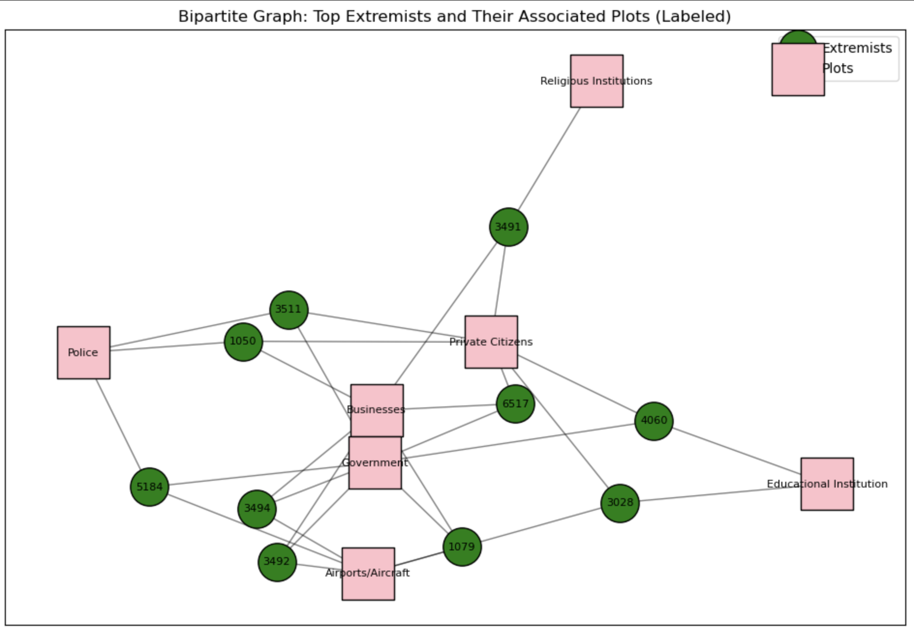
Bipartite Network basis on plots
Notes:
🔹 Key Takeaways
✅ Common Target - "Government"
Both extremists (2057 and 10207) targeted government institutions.
This suggests an anti-establishment ideological link between Jihadist and Militia movements.
✅ Potential Networked Activity
The shared plot type could indicate coordination or ideological overlap.
Extremists with different ideologies may share common enemies (e.g., anti-government stance).
✅ Strengths of the Approach
Bipartite graphs effectively visualize relationships between individuals and their targets.
The mapping of Plot_Target1 to meaningful names enhances interpretability.

Slide 24
CONCLUSION
Early Detection is Critical
Network properties can help identify early indicators of radicalization, allowing proactive intervention.
High-degree & high-betweenness individuals should be priority targets for monitoring & disruption.
Future Radicalization Trends Can Be Predicted
Using network metrics like Jaccard similarity and centrality scores, we can predict future extremist recruiters and reconnections after network disruption.
This enables a data-driven approach to counter-extremism strategies

Slide 25
APPENDIX

Slide 26
Identifying Future Extremist Recruiters
Avg. Degree centrality of N/W: 0.00135
Top 5% Betweenness centrality: 3.64e-05
Avg. Eigenvector centrality: 0.0016
Notes:
Step 1: Degree Centrality Analysis
Rank Node Degree Centrality Network Average (0.00136) Comparison
1 2057 0.009826 7x higher Highly connected
2-10 12015 - 12024 0.006457 5x higher Highly connected
11-19 10206 - 10188 0.00533 - 0.00589 4x higher Well above average
📌 Key Takeaways on Degree Centrality:
✅ All identified recruiters have significantly above-average connectivity (~4x the network average).
✅ 2057 is the most highly connected, meaning it has direct access to the most individuals.
✅ Nodes 12015-12024 are a tight-knit recruiter cluster, indicating potential ideological coordination.
Step 2: Betweenness Centrality Analysis
Rank Node Betweenness Centrality Top 5% Threshold (2.74e-05) Comparison
1 2057 3.24e-03 11.8x above top 5% Very high bridging influence
11-19 4461, 10393, 10001 1.14e-05 - 3.85e-05 Below or near top 5% Moderate bridging influence
2-10 12015 - 12024 1.79e-06 Too low to be a strong bridge Influential, but not connectors
📌 Key Takeaways on Betweenness Centrality:
✅ 2057 is the most critical extremist bridge, meaning it connects otherwise disconnected groups.
✅ 4461, 10393, and 10001 may still play minor bridging roles.
🚨 Nodes 12015-12024 are not significant bridges, meaning they may operate within a single extremist faction rather than across multiple groups.
Step 3: Eigenvector Centrality Analysis
Rank Node Eigenvector Centrality Network Average (0.00136) Comparison
2-10 12015 - 12024 0.2277 166.6x higher Deeply embedded in extremist circles
17 12100 0.2107 154x higher Potential ideological leader
11-19 10206 - 10188 ~9.0e-05 Near network average Not highly influential
1 2057 2.02e-11 Near zero Not an ideological leader
📌 Key Takeaways on Eigenvector Centrality:
✅ 12015 - 12024 are the most ideologically embedded nodes, meaning they may already be recruiters or radical influencers.
✅ 12100 is also highly embedded in the extremist network.
🚨 2057 has near-zero eigenvector centrality, meaning it is a bridge but not a strong influencer in radical ideology.
🚨 10206 - 10188 are not deeply embedded, so they may not be recruiters but could be extremist followers.
Final Verdict: Who Are the Most Concerning Future Recruiters?
🚨 1. Node 2057 is a High-Risk Bridge but NOT an Ideological Recruiter
✅ Extremely high betweenness (11.8x above top 5%) → Critical bridge.
✅ High degree centrality (4.97x above average) → Highly connected.
🚨 Near-zero eigenvector centrality → Not an ideological influencer.
📌 Conclusion: 2057 is a logistics connector rather than a top recruiter but enables extremist collaboration.
🚨 2. Nodes 12015 - 12024 Are the Most Likely Future Recruiters
✅ 4.76x higher degree centrality → Highly connected inside their faction.
🚨 Very low betweenness centrality → They don’t operate across groups but inside a single extremist cell.
✅ Eigenvector centrality (166x higher) → Most ideologically embedded.
📌 Conclusion: They are NOT "bridges" but rather deep within a radicalized extremist group.
🚨 They are the biggest ideological threat because they can radicalize individuals within their extremist faction.
🚨 3. Node 12100 Is Another Potential Ideological Recruiter
✅ Eigenvector centrality (154x higher than network average) → Deeply embedded.
✅ Degree centrality above average → Highly connected.
🚨 Very low betweenness centrality → Does NOT act as a bridge.
📌 Conclusion: 12100 is a strong ideological extremist within a single faction, not across multiple groups.
🚨 4. Nodes 10206 - 10188 Are Less Concerning
✅ Above-average degree centrality → Still well connected.
🚨 Near network-average eigenvector centrality → Not ideological leaders.
📌 Conclusion: These are likely extremist followers, not future recruiters.

Slide 27
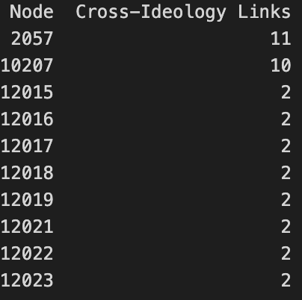
Checking Most Frequent Individuals in External Connections
Top 10 Individuals forming the most cross-Ideological Links
Ideologies of Key Extremists:
Node Ideology
2057 Jihadist
10207 Militia/Soveriegn Citizen/ Anti-Government
Notes:
🚨 Key Findings:
2057 and 10207 are the most dangerous extremist connectors.
They bridge different extremist factions, facilitating ideological cross-pollination.
12015 - 12023 are more localized, likely acting as recruiters inside their own extremist faction.
Metric 2057 10207 Network Average
Cross-Ideology Links 11 10 🔻 Most nodes = 1 or 2
Degree Centrality 0.009738 0.005896 0.00136 (7x higher)
Betweenness Centrality 3.24e-03 3.85e-06 2.74e-05
Eigenvector Centrality 2.02e-11 9.31e-05 0.00136
🚨 Implications:
2057 is not just well connected—it is the single biggest extremist network bridge.
10207 is slightly less connected but still a key inter-ideology influencer.
12015 - 12023 likely operate within a single extremist faction rather than bridging groups.
Step 3: What Does This Mean for Future Radicalization?
✅ 1. 2057 and 10207 Are the Most Dangerous Connectors
✔ They don’t just recruit—they link extremist ideologies together.
✔ These individuals can create hybrid extremist groups, merging far-right, jihadist, or anarchist ideologies.
✔ Removing or monitoring them could prevent new extremist networks from forming.
✅ 2. 12015 - 12023 Are Internal Recruiters, Not External Bridges
✔ They don’t create new ideological mergers but help grow existing extremist factions.
✔ They should still be monitored for localized recruitment.

Slide 28
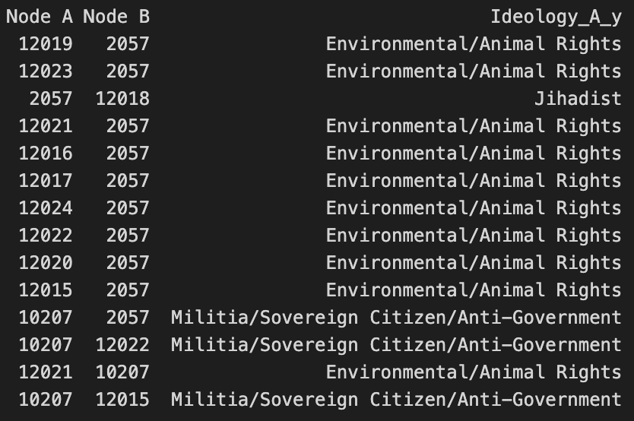
Focus on top 2 extremists
Notes:
Step 1: Key Findings from the Data
✅ 1. Node 2057 (Jihadist) Forms Bridges to Environmental Extremists
2057 is heavily linked to environmental extremists (12015 - 12024).
This suggests potential ideological crossover between eco-terrorism and Jihadist networks.
📌 Implication:
Jihadist groups may be aligning with eco-radicals for shared anti-Western or anti-government sentiments.
These individuals could create hybrid extremist movements, blending climate activism with religious extremism.
2. Node 10207 (Militia/Anti-Government) Also Links to Environmental Extremists
10207 connects with many of the same eco-radical nodes (12015 - 12024).
This suggests common ground between far-right militias and environmental extremists.
📌 Implication:
Far-right militia groups may adopt environmentalist rhetoric to appeal to new recruits.
This could lead to unexpected alliances between groups that typically do not mix ideologically.
3. 2057 (Jihadist) & 10207 (Militia) Are Directly Connected
A Jihadist (2057) and a far-right anti-government extremist (10207) have a direct link.
This suggests a rare but concerning interaction between two opposing ideological groups.
📌 Implication:
This may be a strategic alliance for logistical or operational reasons rather than ideological unity.
Both groups may share a common enemy (government, law enforcement, globalization).
🚨 Potential Risk: If these two groups collaborate operationally, it could lead to high-impact extremist activities.
Step 2: Are Hybrid Extremist Networks Forming?
🚨 1. Signs of Ideological Cross-Pollination
Traditional ideological boundaries are breaking down as extremist groups find common causes.
Eco-extremism is influencing both Jihadist and Anti-Government factions.
🚨 2. New Extremist Cells May Be Emerging
The Jihadist-Eco-Radical connections suggest that new types of radicalization may be happening.
If eco-terrorists and Jihadists begin collaborating, they could target major infrastructure (e.g., oil pipelines, government facilities, corporate centers).

Slide 29
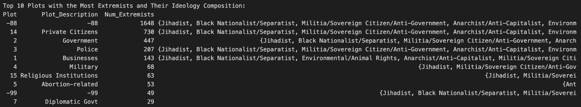
EDA on top plots categories
Notes:
📌 Key Observations
1️⃣ Most Frequently Targeted Plot Categories
No Specific Target (-88):
1648 extremists are categorized under no specific plot (-88).
This suggests ambiguous, failed, or generalized threats rather than targeted attacks.
The wide range of ideologies in this category indicates potential lone actors or decentralized cells.
Private Citizens (14) – 730 extremists:
This is the most frequently targeted identifiable group.
Nearly all extremist ideologies are represented.
Attacks on civilians are often symbolic, high-impact, and media-driven.
Government (2) – 447 extremists:
Common across multiple extremist groups, including:
Jihadists, Anti-Government Militias, Conspiracy Theorists, and White Supremacists.
This suggests anti-establishment motivations across ideologies.
Police (3) – 207 extremists:
Law enforcement is often seen as an immediate threat to extremist groups.
Presence of Anarchists, Anti-Government Militias, and Conspiracy Theorists suggests clashes with state authority.
Businesses (1) – 143 extremists:
Targets include corporate offices, economic hubs, and industries.
Presence of Environmental/Animal Rights groups indicates a focus on economic sabotage.
2️⃣ Target-Specific Ideological Trends
Jihadists & Anti-Government Militias dominate across multiple plot types.
Anti-Abortion extremists specifically target Abortion-Related Institutions (5).
White Supremacists appear in almost every major attack category.
Environmental/Animal Rights groups mainly focus on Businesses (1).
3️⃣ Overlap of Extremist Ideologies
The same target categories are attacked by multiple extremist ideologies.
Private Citizens, Government, and Police are the most ideological diverse targets.
This suggests that while extremists have different motivations, they perceive common enemies.
📊 Actionable Insights
✅ Network Evolution Analysis
Track whether extremist groups shift their targeting strategies over time.
✅ Law Enforcement Implications
Prioritize Private Citizen & Government protection as they are the most frequent targets.
✅ Emerging Threats Analysis
Identify ideological alliances or hybrid extremism by analyzing co-targeting trends.

Slide 30
Prediction Parameter Jaccard Coeff
Predicting Future Extremist Recruiters(removed)
Notes:
Jaccard Coefficient – Used as a metric to measure neighborhood similarity, meaning how many shared neighbors two nodes have.

Slide 31
Predicting Future Extremist Recruiters
Link Prediction Summary & Insights
Network Preparation:
Network Disruption: The original network was "broken" by removing high-degree and high-betweenness nodes.
Prediction on Non-Existing Links: We then built a weighted undirected graph from the surviving nodes and predicted potential links among those nodes that are not currently connected.
Methodology:
Link Prediction Metric: We used the Jaccard Coefficient, which measures neighborhood similarity (i.e., the ratio of shared to total neighbors), to score non-existing links.
Filtering: Only candidate links with a Jaccard Coefficient above the average were considered.
Key Results:
Average Jaccard Coefficient: 0.00016377
Filtered Predictions: 4,643 potential new links exceeded the average Jaccard score.
Node Frequency: Certain nodes appear frequently in these predictions (e.g., Node 1121 appears 46 times, Node 1115 35 times), indicating they are likely to form multiple new connections.
Major Insights:
Sparse Similarity: The very low average Jaccard score suggests that, after disruption, most node pairs share few common neighbors.
Central Connectors: Nodes that repeatedly appear in the filtered predictions likely act as critical connectors or hubs in the network.
Strategic Focus: Focusing on these influential nodes can provide valuable insights into the network’s future evolution and may be key points for intervention.
Notes:
Link Prediction – We analyzed non-existing connections that could emerge in the future.
4,643 potential new links exceeded the average Jaccard score → This means reconnections are still possible despite interventions. ✅ Some nodes appear frequently in predicted links
Node 1121 (46 times), Node 1115 (35 times), etc.
These nodes could act as future key recruiters or central connectors.

Slide 32
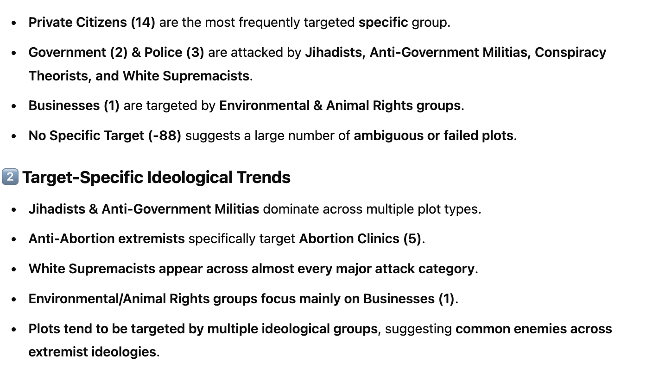
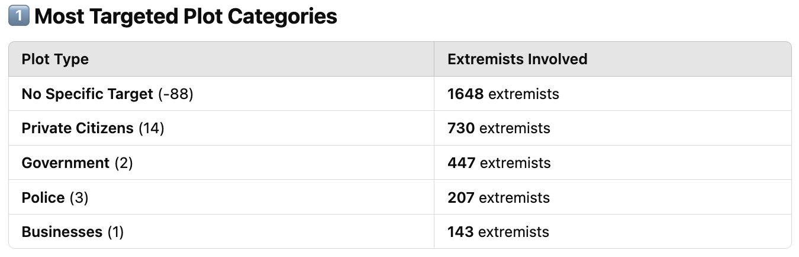
Bipartite N/W of Extremists and Plots
Overlap of Extremist Ideologies
Private Citizens, Government, and Police are attacked by the most ideologically diverse groups.
Suggests that while extremists have different motivations, they perceive common enemies.
Notes:
📌 Key Observations
1️⃣ Most Frequently Targeted Plot Categories
No Specific Target (-88):
1648 extremists are categorized under no specific plot (-88).
This suggests ambiguous, failed, or generalized threats rather than targeted attacks.
The wide range of ideologies in this category indicates potential lone actors or decentralized cells.
Private Citizens (14) – 730 extremists:
This is the most frequently targeted identifiable group.
Nearly all extremist ideologies are represented.
Attacks on civilians are often symbolic, high-impact, and media-driven.
Government (2) – 447 extremists:
Common across multiple extremist groups, including:
Jihadists, Anti-Government Militias, Conspiracy Theorists, and White Supremacists.
This suggests anti-establishment motivations across ideologies.
Police (3) – 207 extremists:
Law enforcement is often seen as an immediate threat to extremist groups.
Presence of Anarchists, Anti-Government Militias, and Conspiracy Theorists suggests clashes with state authority.
Businesses (1) – 143 extremists:
Targets include corporate offices, economic hubs, and industries.
Presence of Environmental/Animal Rights groups indicates a focus on economic sabotage.
2️⃣ Target-Specific Ideological Trends
Jihadists & Anti-Government Militias dominate across multiple plot types.
Anti-Abortion extremists specifically target Abortion-Related Institutions (5).
White Supremacists appear in almost every major attack category.
Environmental/Animal Rights groups mainly focus on Businesses (1).
3️⃣ Overlap of Extremist Ideologies
The same target categories are attacked by multiple extremist ideologies.
Private Citizens, Government, and Police are the most ideological diverse targets.
This suggests that while extremists have different motivations, they perceive common enemies.
📊 Actionable Insights
✅ Network Evolution Analysis
Track whether extremist groups shift their targeting strategies over time.
✅ Law Enforcement Implications
Prioritize Private Citizen & Government protection as they are the most frequent targets.
✅ Emerging Threats Analysis
Identify ideological alliances or hybrid extremism by analyzing co-targeting trends.

